Slide 1

Smart ventilation system for air conditioners
Team members :
Karteeswar K P (20ECR071)
Karthiga K (20ECR073)
Lathika M V (20ECR088)

Slide 2
COMPONENTS:
INTRODUCTION
PROBLEM STATEMENT
IDEA OVERVIEW
MG811 SENSOR
#SPECIFICATIONS
BLOCK DIAGRAM
MODEL DIAGRAM
ADVANTAGES
DRAWBACKS
VALUE PROPOSITION
BUSINESS VENTURE

Slide 3

PROBLEM STATEMENT :
Over the time if the air-conditioned rooms is in closed condition, there is a possibility of increase in carbon dioxide (CO2) level due to the denser population inside.
If the CO2 level exceeds a safety level of 400 ppm it causes respiratory problems, drowsiness and "sick building syndrome" because of this poor indoor air quality.

Slide 4
IDEA OVERVIEW :
A solution to provide ventilation to the airconditioned room is to design a system that can exhaust the air inside the room with excess CO2 to the outdoor environment safely through suitable ducts.
The air conditioner which runs continuously can supply the fresh air that circulates inside the room .
The proposed system has a sensor to sense the level of CO2 inside the room
If the density level of CO2 is exceeded than the safety level, few exhaust fans are operated to provide ventilation without opening the door .
The fixture of exhaust fans must be done so that the air condition does not escape through the duct.
The number of fans depends on the volume of the room.

Slide 5

MG811 CO2 SENSOR:
FEATURES:
This will sense the gaseous carbon dioxide levels by monitoring the amount of
infrared (IR) radiation absorbed by carbon dioxide molecules.
This type of sensor is used in monitoring indoor air quality, landfills, process control, and
controlled environment horticulture.
The MG-811 is highly sensitive to CO2 and less sensitive to alcohol and CO.
PINOUT:
*VCC: 6V ( You can use a4 AA battery holder for this.
AOUT:Analog Output (voltage decreases as CO2 Levels increase.
DOUT: Digital Output that goes HIGH when the threshold is reached (set the threshold by turning the onboard potentiometer).GND: 0V.

Slide 6
SPECIFICATIONS:
SPECIFICATIONS | VALUES
Operating voltage | 6V DC
Characteristic gas | CO2
Detection range | 0 – 10000 ppm
Size | 32mm*22mm*30mm
Interface | Gravity analog
Output | 0 – 2 V

Slide 7
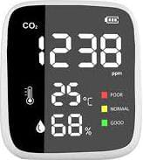
BLOCK DIAGRAM
EXHAUST FAN
ARDUINO STARTER KIT
RELAY
DUCT
(door valve)

Slide 8
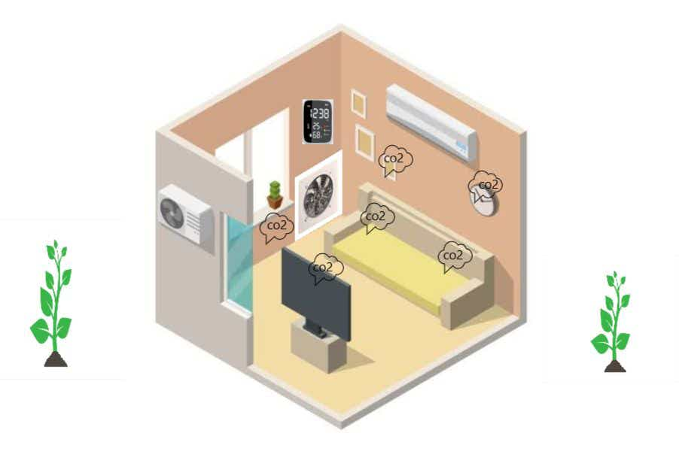
MODEL DESIGN

Slide 9
ADVANTAGES :
Continuous fresh air supply with balanced CO2 level.
Mass leakage of AC by ventilation window is avoided.
It is applicable for workplace like IT companies , hospitals etc...,therefore the working efficiency of the people increases.
Long term ac usage without drowsiness, respiratory problems and dizziness.
It leads to healthy life.

Slide 10
DRAWBACKS:
Installation cost.
Compared to other split or window air conditioners, an inverter air conditioner is a bit expensive as it comes with unique features.

Slide 11
VALUE PROPOSITION:
S.No. | Particulars | Cost in Rs.
1 | Carbon Dioxide Sensor Module | 3500
2 | Arduino Nano CH340 | 300
3 | Exhaust fan (200 mm) | 1300
4 | Flexible Duct pipe (6 inch dia-80 inch length) | 1800
5 | Funnel (9 inch to 6 inch) | 200
6 | Stepper motor with driver | 600
7 | Air vent fan filter cover | 800
8 | Miscellaneous | 1000
 | Total | 9500
The actual required materials and cost may vary depending on room size – volume of the room.
Materials required for one exhaust fan setup is tabulated.

Slide 12
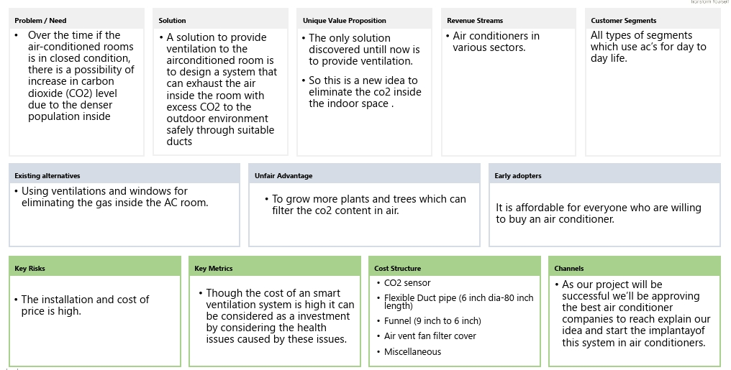
BUSINESS VENTURE

Slide 13
THANK YOU
ANY QUERIES?

